Slide 1
UNIT-IV
Testing Strategies:
A Strategic approach to software testing ,
Strategic issues,
Test strategies for Object Oriented Software,
Test strategies for Web Apps,
Test strategies for Mobile Apps,
Validation testing,
System testing,
the art of debugging.
Testing Conventional Applications:
Software testing fundamentals,
Black box and White box testing,
Basis path testing, Control Structure,
O-O testing methods,
Class level testing methods,
Inter class test case design,
Testing for specialized environments,
architectures and Applications testing patterns.

Slide 2
What is Testing Strategy?
Designing effective test cases is important, but so is the strategy you use to execute them.
Should you develop a formal plan for your tests?
Should you test the entire program as a whole or run tests only on a small part of it?
Should you rerun tests you've already conducted as you add new components to a large system?
When should you involve the customer?
These and many other questions are answered when you develop a software testing strategy.

Slide 3
1.A Strategic Approach to Software Testing
Testing begins at the component level and works "outward" toward the integration of the entire computer-based system.
Different testing techniques are appropriate at different points in time.
Testing is conducted by the developer of the software and (for large projects) an independent test group.
Testing and debugging are different activities, but debugging must be accommodated in any testing strategy.

Slide 4
1.1Verification and Validation
Verification refers to the set of activities that ensure that software correctly implements a specific function.
Validation refers to a different set of activities that ensure that the software that has been built is traceable to customer requirements.
Verification: "Are we building the product right?“
Validation: "Are we building the right product?"

Slide 5
1.2Organizing for Software Testing
The software developer is always responsible for testing the individual units (components) of the program, ensuring that each performs the function for which it was designed.
In many cases, the developer also conducts integration testing.
Only after the software architecture is complete does an independent test group become involved.
The role of an independent test group (ITG) is to remove the inherent problems associated with letting the builder test the thing that has been built. Independent testing removes the conflict of interest that may otherwise be present.

Slide 6
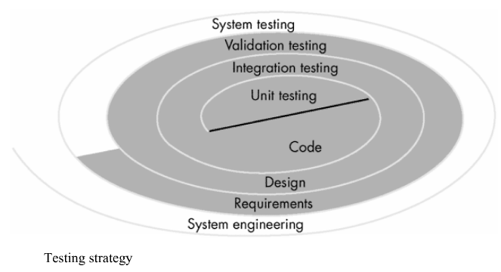
1.3A Software Testing Strategy

Slide 7
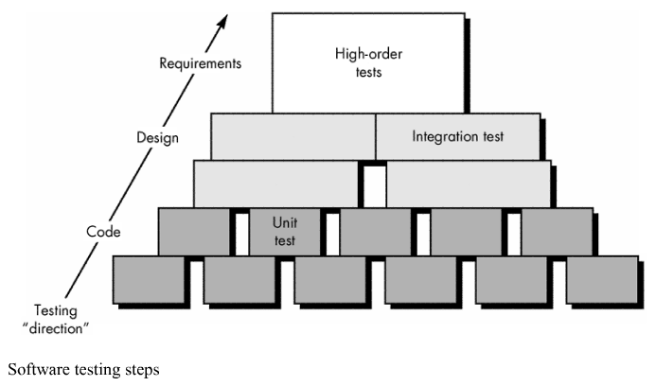

Slide 8
Unit test -white-box techniques
Integration test - black-box + limited white-box
Validation test-black-box techniques
A strategy for software testing may be viewed as spiral.

Slide 9
Unit testing begins at the vortex of the spiral and concentrates on each unit (i.e., component) of the software as implemented in source code.
Testing progresses by moving outward along the spiral to integration testing, where the focus is on design and the construction of the software architecture.
Taking another turn outward on the spiral, we encounter validation testing, where requirements established as part of software requirements analysis are validated against the software that has been constructed.
Finally, system testing, where the software and other system elements are tested as a whole.

Slide 10
1.4Criteria for Completion of Testing
A classic question arises every time software testing is discussed: “When are we done testing—how do we know that we’ve tested enough?”
One response to the question is: “You’re never done testing; the burden simply shifts from you (the software engineer) to the end user.” Every time the user executes a computer program, the program is being tested.
Another response is: “You’re done testing when you run out of time or you run out of money.” Although few practitioners would argue with these responses, you need more rigorous criteria for determining when sufficient testing has been conducted.

Slide 11
The clean room software engineering approach suggests statistical use techniques that execute a series of tests derived from a statistical sample of all possible program executions by all users from a targeted population.
statistical modeling and software reliability theory to predict the completeness of testing. By collecting metrics during software testing and making use of existing software reliability models, it is possible to develop meaningful guidelines for answering the question: “When are we done testing?”

Slide 12
2.Strategic Issues
Specify product requirements in a quantifiable manner long before testing commences.
State testing objectives explicitly. The specific objectives of testing should be stated in measurable terms.
Understand the users of the software and develop a profile for each user category. Use-cases that describe the interaction scenario for each class of user can reduce overall testing effort by focusing testing on actual use of the product.
Develop a testing plan that emphasizes "rapid cycle testing."

Slide 13
Build "robust" software that is designed to test itself. Software should be designed in a manner that uses anti-bugging techniques. That is, software should be capable of diagnosing certain classes of errors. In addition, the design should accommodate automated testing and regression testing.
Use effective formal technical reviews as a filter prior to testing.
Conduct formal technical reviews to assess the test strategy and test cases themselves.
Develop a continuous improvement approach for the testing process.

Slide 14
3.Test strategies for Object Oriented Software
The objective of testing, stated simply, is to find the greatest possible number of errors with a manageable amount of effort applied over a realistic time span.
Although this fundamental objective remains unchanged for object-oriented software, the nature of object-oriented software changes both testing strategy and testing tactics

Slide 15
3.1Unit Testing in the OO Context
When object-oriented software is considered, the concept of the unit changes. Encapsulation drives the definition of classes and objects.
. An encapsulated class is usually the focus of unit testing.Class testing for OO software is the equivalent of unit testing for conventional software.
Unlike unit testing of conventional software, which tends to focus on the algorithmic detail of a module and the data that flow across the module interface, class testing for OO software is driven by the operations encapsulated by the class and the state behavior of the class.

Slide 16
3.2Integration Testing in the OO Context
There are two different strategies for integration testing of OO systems.
The first, thread-based testing, integrates the set of classes required to respond to one input or event for the system. Each thread is integrated and tested individually.
The second integration approach, use-based testing, begins the construction of the system by testing those classes (called independent classes) that use very few server classes. After the independent classes are tested, the next layer of classes, called dependent classes, that use the independent classes are tested.
Cluster testing is one step in the integration testing of OO software

Slide 17
4.Test strategies for WebApps
The content model for the WebApp is reviewed to uncover errors.
The interface model is reviewed to ensure that all use cases can be accommodated.
The design model for the WebApp is reviewed to uncover navigation errors.
The user interface is tested to uncover errors in presentation and/or navigation mechanics.
Each functional component is unit tested.
Navigation throughout the architecture is tested.

Slide 18
7. The WebApp is implemented in a variety of different environmental configurations and is tested for compatibility with each configuration.
8. Security tests are conducted in an attempt to exploit vulnerabilities in the WebApp or within its environment.
9. Performance tests are conducted.
10. The WebApp is tested by a controlled and monitored population of end users.

Slide 19
5.Test strategies for MobileApps
Mobile application testing is the process of validating a mobile app for its functionality, usability, and consistency before its release.
Efficient mobile app testing ensures and verifies the app's potential to meet the expected technical and business requirements and deliver the desired consumer experience.
Test plan assists in determining possible issues and dependencies in order to identify risks, while test strategies are long-term plans of action that can help retrieve information that is not project specific and put into a test approach.

Slide 20
1. Understand Mobile Testing Challenges
2. Select Your Mobile Device Mix for Testing
3. Incorporate a Mix of Real Devices and Emulators and Simulators
4. Know the Types of Mobile Application Testing
5. Determine Your Manual Testing vs. Automated Testing Use Cases

Slide 21
6. Don’t Forget Mobile Beta Testing
7. Choose Your Test Automation Tool
8. Choose Where to Run Your Mobile Tests: In the Cloud or In-House.

Slide 22
6.Validation testing
Validation testing begins at the culmination of integration testing, when individual components have been exercised, the software is completely assembled as a package, and interfacing errors have been uncovered and corrected.
At the validation or system level, the distinction between conventional software, object-oriented software, and WebApps disappears.
Testing focuses on user-visible actions and user-recognizable output from the system

Slide 23
6.1Validation-Test Criteria
Software validation is achieved through a series of tests that demonstrate conformity with requirements.
A test plan outlines the classes of tests to be conducted, and a test procedure defines specific test cases that are designed to ensure that all functional requirements are satisfied, all behavioral characteristics are achieved, all content is accurate and properly presented, all performance requirements are attained, documentation is correct, and usability and other requirements are met

Slide 24
6.2Configuration Review
An important element of the validation process is a configuration review.
The intent of the review is to ensure that all elements of the software configuration have been properly developed, are cataloged, and have the necessary detail to bolster the support activities.
The configuration review, sometimes called an audit.

Slide 25
6.3Alpha and Beta Testing
The alpha test is conducted at the developer’s site by a representative group of end users. The software is used in a natural setting with the developer “looking over the shoulder” of the users and recording errors and usage problems.
Alpha tests are conducted in a controlled environment.

Slide 26
The beta test is conducted at one or more end-user sites. Unlike alpha testing, the developer generally is not present. Therefore, the beta test is a “live” application of the software in an environment that cannot be controlled by the developer.
The customer records all problems (real or imagined) that are encountered during beta testing and reports these to the developer at regular intervals. As a result of problems reported during beta tests, you make modifications and then prepare for release of the software product to the entire customer base

Slide 27
7. System testing
System testing is actually a series of different tests whose primary purpose is to fully exercise the computer-based system.
Although each test has a different purpose, all work to verify that system elements have been properly integrated and perform allocated functions

Slide 28
1. Recovery Testing is a system test that forces the software to fail in a variety of ways and verifies that recovery is properly performed.
If recovery is automatic (performed by the system itself), reinitialization, checkpointing mechanisms, data recovery, and restart are evaluated for correctness.
If recovery requires human intervention, the mean-time-to-repair (MTTR) is evaluated to determine whether it is within acceptable limits.

Slide 29
2. Security testing attempts to verify that protection mechanisms built into a system will, in fact, protect it from improper penetration.
The system’s security must, of course, be tested for invulnerability from frontal attack—but must also be tested for invulnerability from flank or rear attacking.
The role of the system designer is to make penetration cost more than the value of the information that will be obtained.

Slide 30
3. Stress Testing executes a system in a manner that demands resources in abnormal quantity, frequency, or volume. For example,
(1) special tests may be designed that generate ten interrupts per second, when one or two is the average rate,
(2) input data rates may be increased by an order of magnitude to determine how input functions will respond,
(3) test cases that require maximum memory or other resources are executed,
(4) test cases that may cause thrashing in a virtual operating system are designed,
(5) test cases that may cause excessive hunting for disk-resident data are created.

Slide 31
4.Performance Testing is designed to test the run-time performance of software within the context of an integrated system. Performance testing occurs throughout all steps in the testing process.
Performance tests are often coupled with stress testing and usually require both hardware and software instrumentation.
External instrumentation can monitor execution intervals, log events (e.g., interrupts) as they occur, and sample machine states on a regular basis.

Slide 32
5.Deployment Testing
In many cases, software must execute on a variety of platforms and under more than one operating system environment.
Deployment testing, sometimes called configuration testing, exercises the software in each environment in which it is to operate.
In addition, deployment testing examines all installation procedures and specialized installation software (e.g., “installers”) that will be used by customers, and all documentation that will be used to introduce the software to end users

Slide 33
8.The art of debugging
Debugging occurs as a consequence of successful testing.
That is, when a test case uncovers an error, debugging is the process that results in the removal of the error.
Although debugging can and should be an orderly process, it is still very much an art.
the external manifestation of the error and its internal cause may have no obvious relationship to one another.

Slide 34
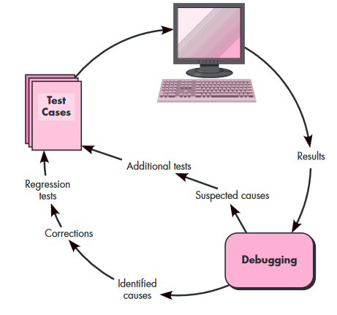
8.1 The Debugging Process
The debugging process will usually have one of two outcomes:
(1)the cause willbe found and corrected or
(2) the cause will not be found.

Slide 35
few characteristics of bugs
1.The symptom and the cause may be geographically remote. That is, the symptom may appear in one part of a program, while the cause may actually be located at a site that is far removed.
2. The symptom may disappear (temporarily) when another error is corrected.
3.The symptom may actually be caused by non errors( inaccuracies).
4. The symptom may be caused by human error that is not easily traced.

Slide 36
5. The symptom may be a result of timing problems, rather than processing problems.
6. It may be difficult to accurately reproduce input conditions(e.g., areal-time application in which input ordering is indeterminate).
7. The symptom may be intermittent. This is particularly common in embedded systems that couple hardware and software inextricably.
8. The symptom may be due to causes that are distributed across a number of tasks running on different processors.

Slide 37
8.2 Psychological Considerations
Debugging is one of the more frustrating parts of programming.
It has elements of problem solving or brain teasers, coupled with the annoying recognition that you have made a mistake.
Heightened anxiety and the unwillingness to accept the possibility of errors increases the task difficulty.
Fortunately, there is a great sigh of relief and a lessening of tension when the bug is ultimately . . . corrected.

Slide 38
8.3 Debugging Strategies
In general, three debugging strategies have been proposed
(1)Brute force,
(2) backtracking, and
(3) cause elimination.
Each of these strategies can be conducted manually, but modern debugging tools can make the process much more effective.

Slide 39
Debugging tactics. The brute force category of debugging is probably the most common and least efficient method for isolating the cause of a software error. You apply brute force debugging methods when all else fails.
Backtracking is a fairly common debugging approach that can be used successfully in small programs.
The third approach to debugging—cause elimination—is manifested by induction or deduction and introduces the concept of binary partitioning. Data related to the error occurrence are organized to isolate potential causes.

Slide 40
Automated debugging.
Integrated development environments (IDEs) provide a way to capture some of the language-specific re determined errors (e.g., missing end-of-statement characters, undefined variables, and so on) without requiring compilation.”
A wide variety of debugging compilers, dynamic debugging aids (“tracers”),automatic test-case generators, and cross-reference mapping tools are available. However, tools are not a substitute for careful evaluation based on a complete design model and clear source code.

Slide 41
The people factor
Any discussion of debugging approaches and tools is incom-plete without mention of a powerful ally—other people! A fresh viewpoint, un-clouded by hours of frustration, can do wonders.
A final maxim for debugging might be: “When all else fails, get help!”

Slide 42
8.4 Correcting the Error
Is the cause of the bug reproduced in another part of the program? In many situations, a program defect is caused by an erroneous pattern of logic that maybe reproduced elsewhere.
What “next bug” might be introduced by the fix I’m about to make? Before the correction is made, the source code should be evaluated to assess coupling of logic and data structures. If the correction is to be made in a highly coupled section of the program, special care must be taken when any change is made.
What could we have done to prevent this bug in the first place? This question is the first step toward establishing a statistical software quality assurance approach .If you correct the process as well as the product, the bug will be removed from the current program and may be eliminated from all future programs.

Slide 43
Testing Conventional Applications:
1.Software testing fundamentals
Testability:characteristics lead to testable software are
Operability.
Observability.
Controllability.
Decomposability.
Simplicity.
Stability.
Understandability

Slide 44
Test Characteristics
A good test has a high probability of finding an error.
A good test is not redundant.
A good test should be “best of breed”.
A good test should be neither too simple nor too complex.

Slide 45
2.White-box testing, sometimes called glass-box testing, is a test-case design philosophy that uses the control structure described as part of component-level design to derive test cases. Using white-box testing methods, you can derive test cases that
(1) guarantee that all independent paths within a module have been exercised at least once,
(2) exercise all logical decisions on their true and false sides,
(3) Execute all loops at their boundaries and within their operational bounds, and
(4) exercise internal data structures to ensure their validity.

Slide 46
3.Basis path testing
The basis path method enables the test-case designer to derive a logical complexity measure of a procedural design and use this measure as a guide for defining a basis set of execution paths.
Test cases derived to exercise the basis set are guaranteed to execute every statement in the program at least one time during testing

Slide 47
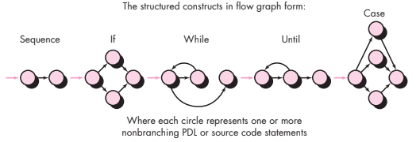
3.1Flow Graph Notation
A simple notation for the representation of control flow, called a flow graph

Slide 48
Each circle, called a flow graph node, represents one or more procedural statements. A sequence of process boxes and a decision diamond can map into a single node.
The arrows on the flow graph, called edges or links, represent flow of control and are analogous to flowchart arrows.
An edge must terminate at a node, even if the node does not represent any procedural statements (e.g., see the flow graph symbol for the if-then-else construct).
Areas bounded by edges and nodes are called regions. When counting regions, we include the area outside the graph as a region.

Slide 49
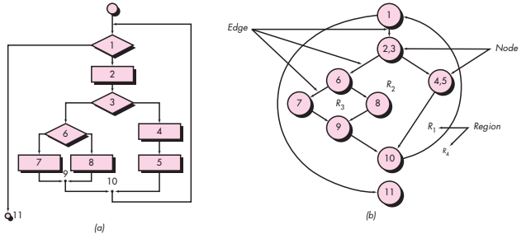

Slide 50
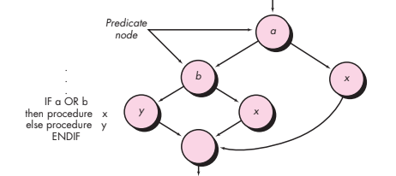


Slide 51
3.2 Independent Program Paths
An independent path is any path through the program that introduces at least one new set of processing statements or a new condition.
When stated in terms of a flow graph, an independent path must move along at least one edge that has not been traversed before the path is defined.
Path 1: 1-11
Path 2: 1-2-3-4-5-10-1-11
Path 3: 1-2-3-6-8-9-10-1-11
Path 4: 1-2-3-6-7-9-10-1-11
Note that each new path introduces a new edge.
The path 1-2-3-4-5-10-1-2-3-6-8-9-10-1-11
is not considered to be an independent path because it is simply a combination of already specified paths and does not traverse any new edges.

Slide 52
Cyclomatic complexity is a software metric that provides a quantitative measure of the logical complexity of a program.
cyclomatic complexity defines the number of independent paths in the basis set of a program and provides you with an upper bound for the number of tests that must be conducted to ensure that all statements have been executed at least once.
Complexity is computed in one of three ways:
the cyclomatic complexity can be computed using each of the algorithms just noted:
1. The flow graph has four regions.
2. V(G) 11 edges - 9 nodes + 2 =4.
3. V(G) 3 predicate nodes +1 = 4.

Slide 53
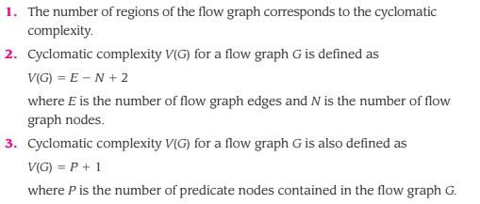

Slide 54
3.3 Deriving Test Cases
Using the design or code as a foundation, draw a corresponding flow graph.
Determine the cyclomatic complexity of the resultant flow graph.
Determine a basis set of linearly independent paths.
Prepare test cases that will force execution of each path in the basis set.

Slide 55
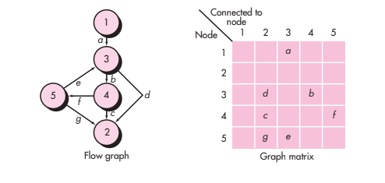
3.4Graph Matrices

Slide 56
4.control structure testing.
4.1Condition Testing
Condition testing is a test-case design method that exercises the logical conditions contained in a program module.
The condition testing method focuses on testing each condition in the program to ensure that it does not contain errors.
A compound condition is composed of two or more simple conditions, Boolean operators, and parentheses.
A simple condition is a Boolean variable or a relational expression, possibly preceded with one NOT (¬) operator.

Slide 57
4.2 Data Flow Testing
The data flow testing method selects test paths of a program according to the locations of definitions and uses of variables in the program.
For a statement with S as its statement number,
DEF(S) {X | statement S contains a definition of X}
USE(S) {X | statement S contains a use of X}
If statement S is an if or loop statement, its DEF set is empty and its USE set is based on the condition of statement S.
The definition of variable X at statement S is said to be live at statement S’ if there exists a path from statement S to statement S’ that contains no other definition of X.

Slide 58
A definition-use (DU) chain of variable X is of the form [X, S, S’], where S and S’ are statement numbers, X is in DEF(S) and USE(S’), and the definition of X in statement S is live at statement S’.
One simple data flow testing strategy is to require that every DU chain be covered at least once. We refer to this strategy as the DU testing strategy.

Slide 59
4.3 Loop Testing
Loop testing is a white-box testing technique that focuses exclusively on the validity of loop constructs. Four different classes of loops can be defined:
simple loops,
concatenated loops,
nested loops, and
unstructured loops.

Slide 60
Simple loops
The following set of tests can be applied to simple loops, where n is the maximum number of allowable passes through the loop.
Skip the loop entirely.
2. Only one pass through the loop.
3. Two passes through the loop.
4. m passes through the loop where m < n.
5. n -1, n, n + 1 passes through the loop.

Slide 61
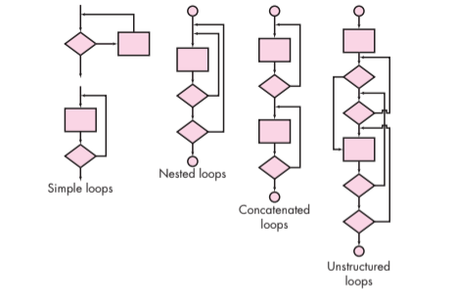

Slide 62
Nested loops
Start at the innermost loop. Set all other loops to minimum values.
2. Conduct simple loop tests for the innermost loop while holding the outer loops at their minimum iteration parameter (e.g., loop counter) values. Add other tests for out-of-range or excluded values.
3. Work outward, conducting tests for the next loop, but keeping all other outer loops at minimum values and other nested loops to “typical” values.
4. Continue until all loops have been tested.

Slide 63
Concatenated loops
Concatenated loops can be tested using the approach defined for simple loops, if each of the loops is independent of the other. However, if two loops are concatenated and the loop counter for loop 1 is used as the initial value for loop 2, then the loops are not independent. When the loops are not independent, the approach applied to nested loops is recommended.
Unstructured loops
Whenever possible, this class of loops should be redesigned to reflect the use of the structured programming constructs

Slide 64
5.Black-box testing
Black-box testing, also called behavioral testing, focuses on the functional requirements of the software.
Black-box testing attempts to find errors in the following categories:
(1) incorrect or missing functions,
(2) interface errors,
(3) errors in data structures or external database access,
(4) behavior or performance errors, and
(5) initialization and termination errors.

Slide 65
5.1 Graph-Based Testing Methods
The first step in black-box testing is to understand the objects that are modeled in software and the relationships that connect these objects.
Once this has been accomplished, the next step is to define a series of tests that verify “all objects have the expected relationship to one another”.

Slide 66
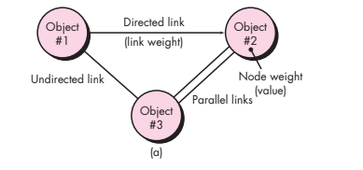

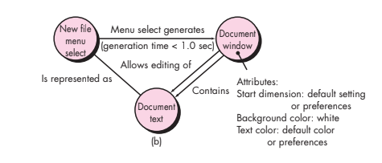

Slide 67
Graph—a collection of nodes that represent objects
links that represent the relationships between objects,
node weights that describe the properties of a node (e.g., a specific data value or state behavior), and
link weights that describe some characteristic of a link.

Slide 68
behavioral testing methods that can make use of graphs
Transaction flow modeling. The nodes represent steps in some transaction e.g., the steps required to make an airline reservation using an online service.
Finite state modeling. The nodes represent different user-observable states of the software and the links represent the transitions that occur to move from state to state .
The state diagram can be used to assist in creating graphs of this type.
Data flow modeling. The nodes are data objects, and the links are the transformations that occur to translate one data object into another.
Timing modeling. The nodes are program objects, and the links are the sequential connections between those objects. Link weights are used to specify the required execution times as the program executes.

Slide 69
5.2 Equivalence Partitioning
Equivalence partitioning is a black-box testing method that divides the input domain of a program into classes of data from which test cases can be derived.
Typically, an input condition is either a specific numeric value, a range of values, a set of related values, or a Boolean condition. Equivalence classes may be defined according to the following guidelines:
1. If an input condition specifies a range, one valid and two invalid equivalence
classes are defined.
2. If an input condition requires a specific value, one valid and two invalid
equivalence classes are defined.
3. If an input condition specifies a member of a set, one valid and one invalid
equivalence class are defined.
4. If an input condition is Boolean, one valid and one invalid class are defined.

Slide 70
5.3 Boundary Value Analysis
Boundary value analysis leads to a selection of test cases that exercise bounding values.
Boundary value analysis is a test-case design technique that complements equivalence partitioning.
Rather than selecting any element of an equivalence class, BVA leads to the selection of test cases at the “edges” of the class.
Rather than focusing solely on input conditions, BVA derives test cases from the output domain as well.

Slide 71
Guidelines for BVA are similar in many respects to those provided for equivalence partitioning:
1. If an input condition specifies a range bounded by values a and b, test cases should be designed with values a and b and just above and just below a and b.
2. If an input condition specifies a number of values, test cases should be developed that exercise the minimum and maximum numbers. Values just above and below minimum and maximum are also tested.
3. Apply guidelines 1 and 2 to output conditions. For example, assume that a temperature versus pressure table is required as output from an engineering analysis program. Test cases should be designed to create an output report that produces the maximum (and minimum) allowable number of table entries.

Slide 72
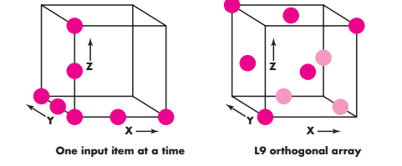
5.4Orthogonal Array Testing
Orthogonal array testing can be applied to problems in which the input domain is relatively small but too large to accommodate exhaustive testing.
The orthogonal array testing method is particularly useful in finding region faults—an error category associated with faulty logic within a software component.

Slide 73
Phadke assesses the result of tests using the L9 orthogonal array in the following manner:
Detect and isolate all single mode faults. A single mode fault is a consistent problem with any level of any single parameter.
Detect all double mode faults. If there exists a consistent problem when specific levels of two parameters occur together, it is called a double mode fault.
Multimode faults. Orthogonal arrays can assure the detection of only single and double mode faults. However, many multimode faults are also detected by these tests.

Slide 74
6.Testing for specialized environments, architectures and Applications testing patterns.
6.1 Testing GUIs
Graphical user interfaces (GUIs) will present you with interesting testing challenges. Because reusable components are now a common part of GUI development environments, the creation of the user interface has become less time consuming and more precise .
But, at the same time, the complexity of GUIs has grown, leading to more difficulty in the design and execution of test cases.
Because of the large number of permutations associated with GUI operations, GUI testing should be approached using automated tools. A wide array of GUI testing tools has appeared on the market over the past few years.

Slide 75
6.2 Testing of Client-Server Architectures
In general, the testing of client-server software occurs at three different levels:
Individual client applications are tested in a “disconnected” mode; the operation of the server and the underlying network are not considered.
(2) The client software and associated server applications are tested in concert, but network operations are not explicitly exercised.
(3) The complete client-server architecture, including network operation and performance, is tested.

Slide 76
Testing approaches are commonly encountered for client-server applications:
• Application function tests-The application is tested in stand-alone fashion in an attempt to uncover errors in its operation.
• Server tests-The coordination and data management functions of the server are tested. Server performance (overall response time and data throughput) is also considered.
• Database tests-The accuracy and integrity of data stored by the server is tested. Transactions posted by client applications are examined to ensure that data are properly stored, updated, and retrieved. Archiving is also tested.
• Transaction tests-A series of tests are created to ensure that each class of transactions is processed according to requirements. Tests focus on the correctness of processing and also on performance issues (e.g., transaction processing times and transaction volume).
• Network communication tests. These tests verify that communication among the nodes of the network occurs correctly and that message passing, transactions, and related network traffic occur without error. Network security tests may also be conducted as part of these tests.

Slide 77
6.3 Testing Documentation and Help Facilities
Errors in documentation can be as devastating to the acceptance of the program as errors in data or source code. Documentation testing can be approached in two phases.
The first phase, technical review, examines the document for editorial clarity.
The second phase, live test, uses the documentation in conjunction with the actual program.

Slide 78
6.4 Testing for Real-Time Systems
Test-case design methods for real-time systems continue to evolve. However, an overall four-step strategy can be proposed:
• Task testing. The first step in the testing of real-time software is to test
each task independently. That is, conventional tests are designed for each task and executed independently during these tests.
• Behavioral testing-Using system models created with automated tools, it is possible to simulate the behavior of a real-time system and examine its behavior as a consequence of external events.
Intertask testing- Once errors in individual tasks and in system behavior have been isolated, testing shifts to time-related errors.
• System testing-testing. Software and hardware are integrated, and a full range of system tests are conducted in an attempt to uncover errors at the software-hardware interface. Most real-time systems process interrupts.

Slide 79
7.object-oriented Testing methods
Test-case design methods for object-oriented software continue to evolve.
Each test case should be uniquely identified and explicitly associated with the class to be tested.
2. The purpose of the test should be stated.
3. A list of testing steps should be developed for each test and should contain:
a. A list of specified states for the class that is to be tested
b. A list of messages and operations that will be exercised as a consequence of the test
c. A list of exceptions that may occur as the class is tested
d. A list of external conditions
e. Supplementary information that will aid in understanding or implementing the test

Slide 80
7.1 The Test-Case Design Implications of OO Concepts
7.2Applicability of Conventional Test-Case Design Methods
7.3 Fault-Based Testing
7.4 Test Cases and the Class Hierarchy
7.5 Scenario-Based Test Design

Slide 81
7.1 The Test-Case Design Implications of OO Concepts
As a class evolves through the requirements and design models, it becomes a target for test-case design.
Because attributes and operations are encapsulated, testing operations outside of the class is generally unproductive.
Although encapsulation is an essential design concept for OO, it can create a minor obstacle when testing.
Inheritance may also present you with additional challenges during test-case design.
In addition, multiple inheritance complicates testing further by increasing the number of contexts for which testing is required

Slide 82
7.2 Applicability of Conventional Test-Case Design Methods
Black-box testing methods are as appropriate for OO systems as they are for systems developed using conventional software engineering methods.
The white-box testing methods can be applied to the operations defined for a class. Basis path, loop testing, or data flow techniques can help to ensure that every statement in an operation has been tested.

Slide 83
7.3 Fault-Based Testing
The object of fault-based testing within an OO system is to design tests that have a high likelihood of uncovering plausible faults.
Because the product or system must conform to customer requirements, preliminary planning required to perform fault- based testing begins with the analysis model.
Integration testing looks for plausible faults in operation calls or message connections. Three types of faults are encountered in this context: unexpected result, wrong operation/message used, and incorrect invocation.
The focus of integration testing is to determine whether errors exist in the calling code, not the called code.

Slide 84
7.4 Test Cases and the Class Hierarchy
Inheritance does not obviate the need for thorough testing of all derived classes. In fact, it can actually complicate the testing process.
Consider the situation. A class Base contains operations inherited() and redefined(). A class Derived redefines redefined() to serve in a local context. There is little doubt that Derived::redefined() has to be tested because it represents a new design and new code. But does Derived::inherited() have to be retested?
Test inputs may be appropriate for both base and derived classes, but the expected results may .differ in the derived class

Slide 85
7.5 Scenario-Based Test Design
Fault-based testing misses two main types of errors:
(1)incorrect specifications and (2) interactions among subsystems.
Scenario-based testing concentrates on what the user does, not what the product does.
Scenarios uncover interaction errors. But to accomplish this, test cases must be more complex and more realistic than fault-based tests.
Scenario-based testing tends to exercise multiple subsystems in a single test.

Slide 86
7.6 Testing Surface Structure and Deep Structure
Surface structure refers to the externally observable structure of an OO program. That is, the structure that is immediately obvious to an end user.
Deep structure refers to the internal technical details of an OO program, that is, the structure that is understood by examining the design and/or code.
Deep structure testing is designed to exercise dependencies, behaviors, and communication mechanisms that have been established as part of the design model for OO software.

Slide 87
8.Class level testing methods
Testing “in the small” focuses on a single class and the methods that are encapsulated by the class. Random testing and partitioning are methods that can be used to exercise a class during OO testing.
8.1 Random Testing for OO Classes
consider a banking application in which an Account class has the following operations:
open(),
setup(),
deposit(),
with-draw(),
balance(),
summarize(),
creditLimit(), and
close()

Slide 88
Each of these operations may be applied for Account, but certain constraints are implied by the nature of the problem.
Even with these constraints, there are many permutations of the operations.
The minimum behavioral life history of an instance of Account includes the following operations:
open•setup•deposit•withdraw•close
open•setup•deposit•[deposit|withdraw|balance|summarize|creditLimit] n•withdraw•close
Test case r1: open•setup•deposit•deposit•balance•summarize•withdraw•close
Test case r2: open•setup•deposit•withdraw•deposit•balance•creditLimit•withdraw•close

Slide 89
8.2 Partition Testing at the Class Level
Partition testing reduces the number of test cases required to exercise the class in much the same manner as equivalence partitioning for traditional software.
Input and output are categorized and test cases are designed to exercise each category. But how are the partitioning categories derived?
State-based partitioning categorizes class operations based on their ability to change the state of the class.
Attribute-based partitioning categorizes class operations based on the attributes that they use.
Category-based partitioning categorizes class operations based on the generic function that each performs.

Slide 90
9.INTER CLASS Test-case design
Test-case design becomes more complicated as integration of the object-oriented system begins.
It is at this stage that testing of collaborations between classes must begin.
Like the testing of individual classes, class collaboration testing can be accomplished by applying random and partitioning methods, as well as scenario-based testing and behavioral testing.

Slide 91
9.1 Multiple Class Testing
1.For each client class, use the list of class operations to generate a series of random test sequences. The operations will send messages to other server classes.
2. For each message that is generated, determine the collaborator class and the corresponding operation in the server object.
3. For each operation in the server object (that has been invoked by messages sent from the client object), determine the messages that it transmits.
4. For each of the messages, determine the next level of operations that are invoked and incorporate these into the test sequence.

Slide 92
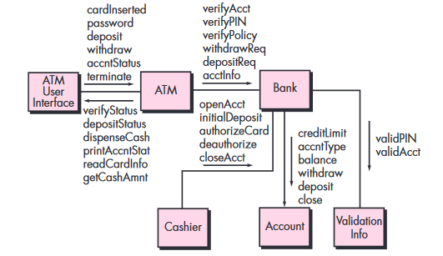


Slide 93
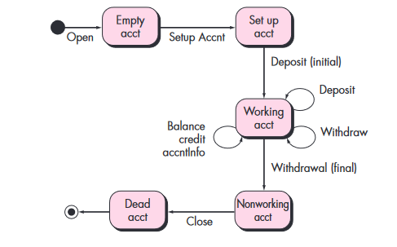

9.2 Tests Derived from Behavior Models
The state diagram for a class can be used to help derive a sequence of tests that will exercise the dynamic behavior of the class. The tests to be designed should achieve coverage of every state.

Slide 94
More test cases could be derived to ensure that all behaviors for the class have been adequately exercised. In situations in which the class behavior results in a collaboration with one or more classes, multiple state diagrams are used to track the behavioral flow of the system.
The state model can be traversed in a “breadth-first” manner.
In this context, breadth-first implies that a test case exercises a single transition and that when a new transition is to be tested only previously tested transitions are used.

